Slide 1
Review on Logistic Regression & Regularization, GD + Spam Classification

Slide 2
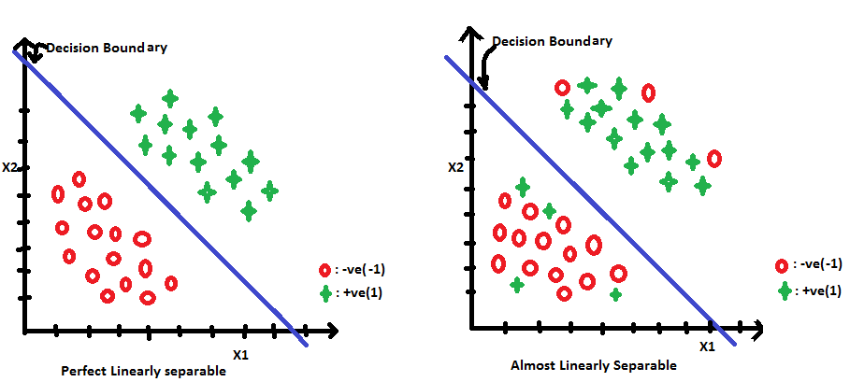
Linear Classifier

Slide 3
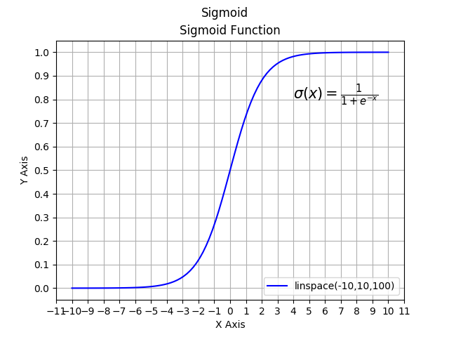
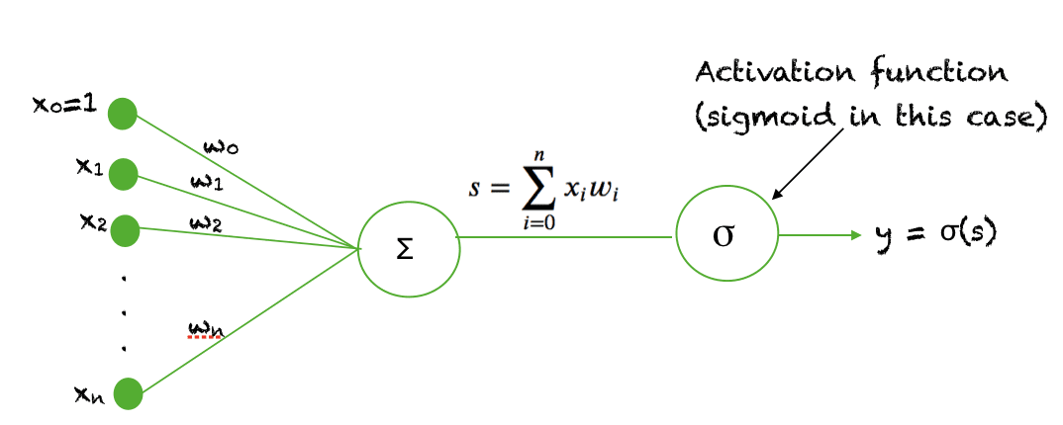
Logistic Regression
Linear Model – Decision Boundary is Linear, y = w^Tx + b.
w^Txi + b > 0 for all yi labelled as ‘1’, while w^Txi + b < 0 for all yi labelled as ‘0’
Assume P(yi=1|xi,w,b) = 1/(1+exp-(w^Txi+b)).

Slide 4
Logistic Regression
Loss function: J(w) = min_w –(ylog(yˆ)+(1−y )log(1−yˆ)), where yˆ = sigmoid(w^Tx+b). –(log(yˆ)+(1−y )log(1−yˆ)) is also called ‘binary cross entropy’.

Slide 5
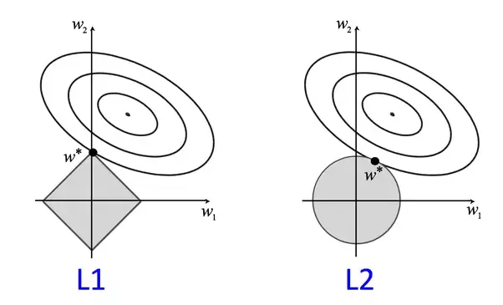
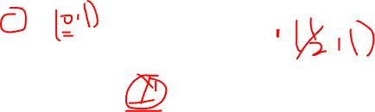
Regularization L1 vs L2 (Shrinkage)
L2 regularization
L1 regularization

Slide 6
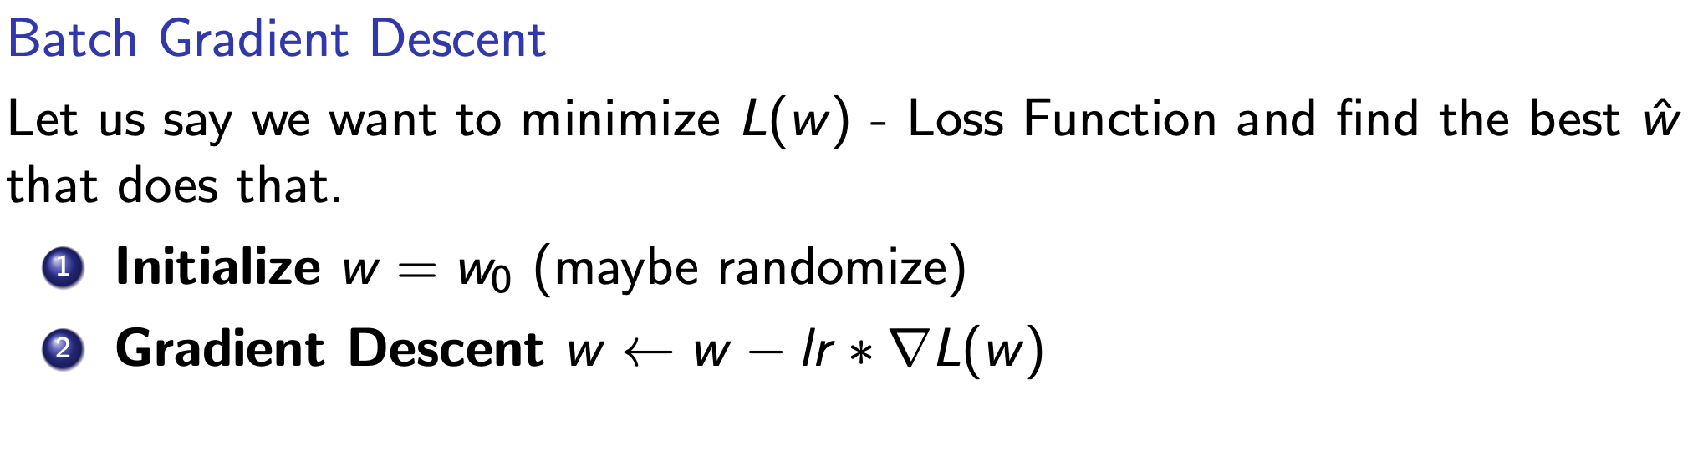
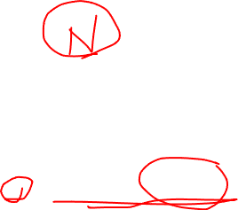
(Batch)Gradient Descent v.s Mini-Batch SGD
You use all data points to calculate gradient in Gradient Descent.

Slide 7
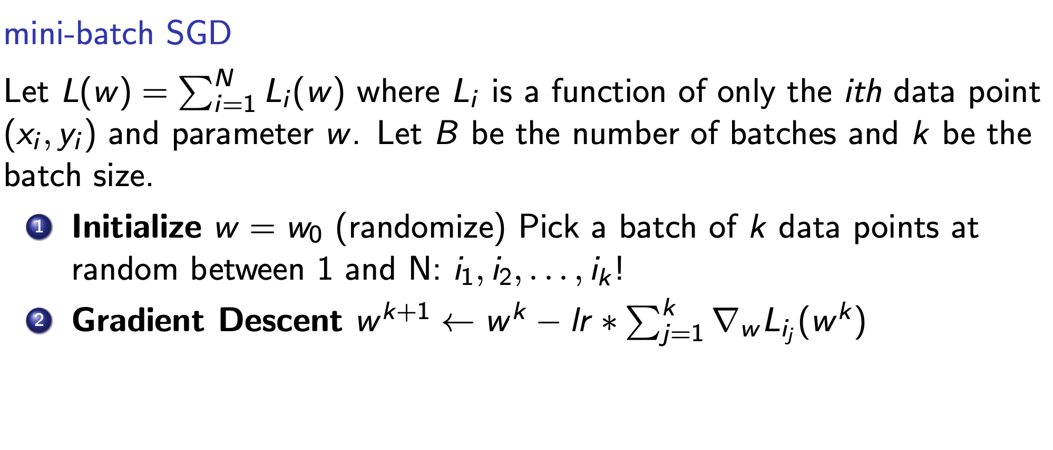

Gradient Descent v.s Mini-Batch SGD

Slide 8
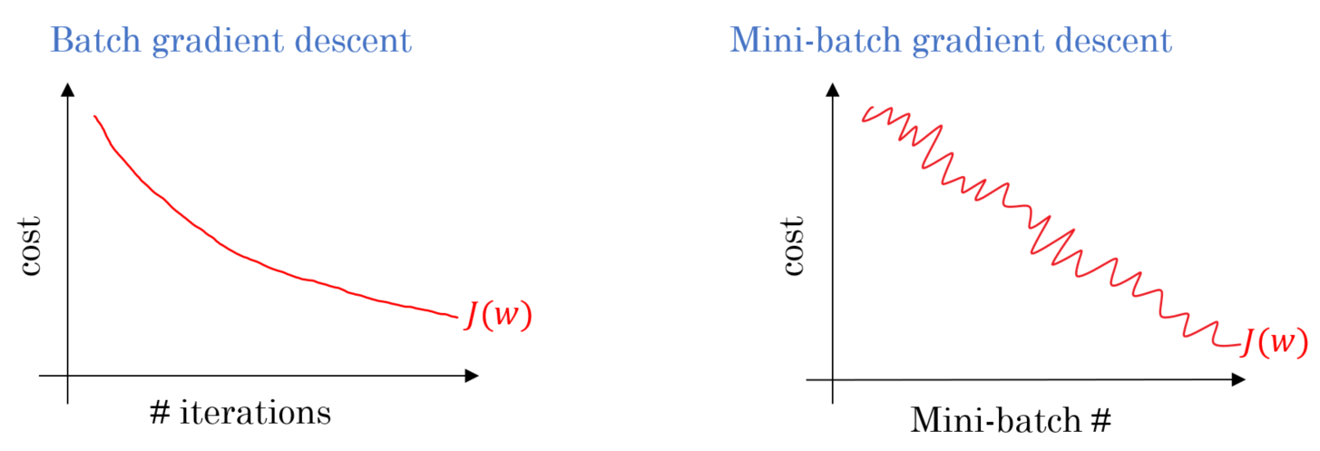

Gradient Descent v.s Mini-Batch SGD

Slide 9
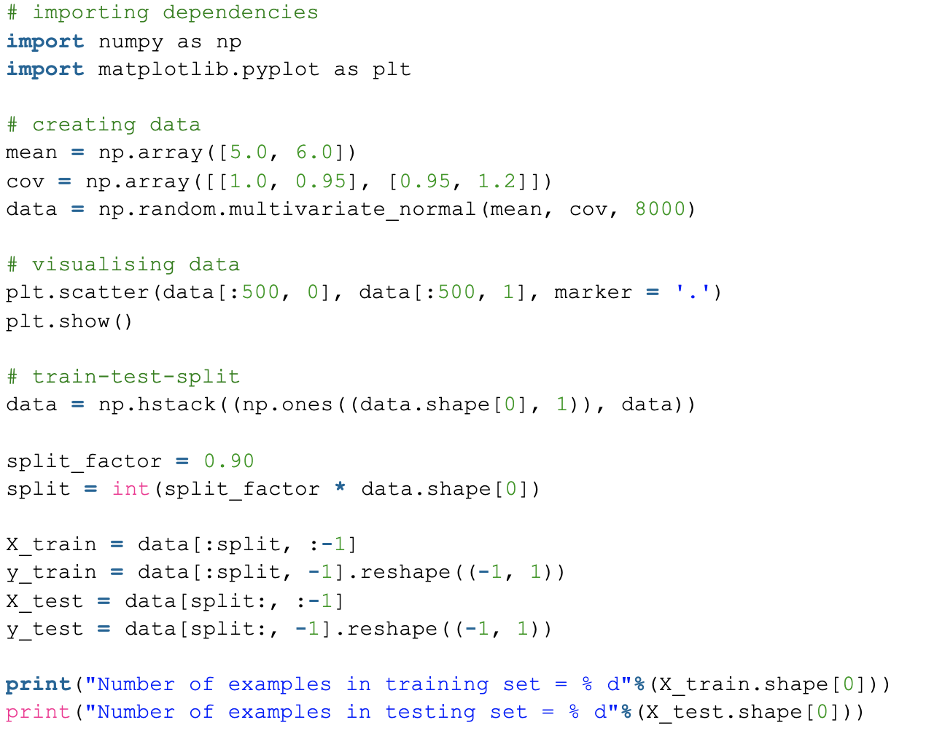
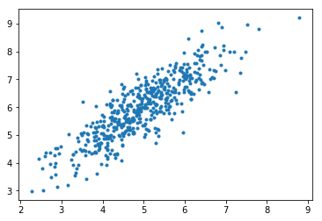

Linear Regression As an Example
Reference: https://www.geeksforgeeks.org/ml-mini-batch-gradient-descent-with-python/

Slide 10
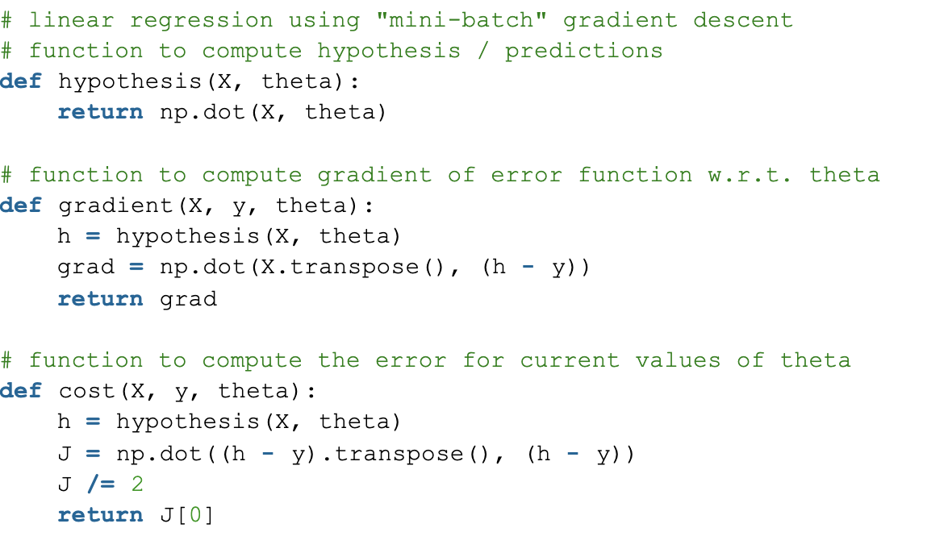
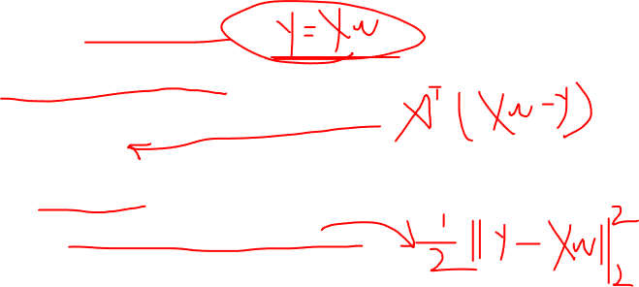
Linear Regression As an Example
Reference: https://www.geeksforgeeks.org/ml-mini-batch-gradient-descent-with-python/

Slide 11
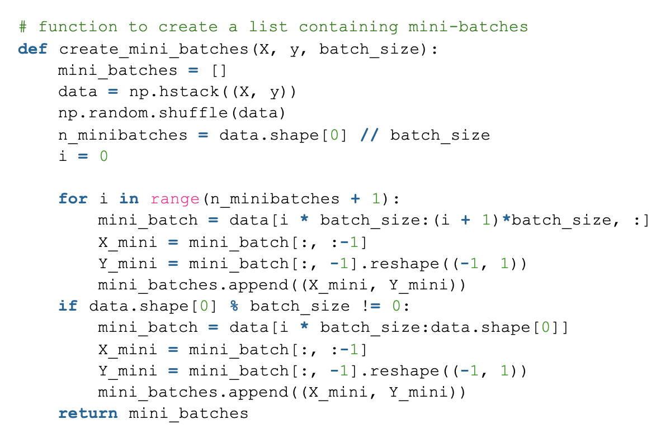
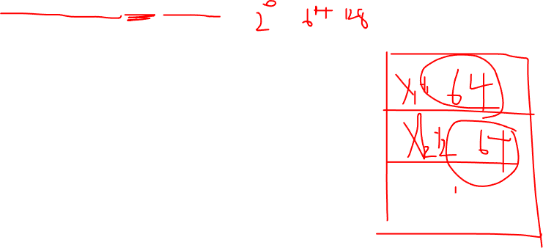
Linear Regression As an Example
Reference: https://www.geeksforgeeks.org/ml-mini-batch-gradient-descent-with-python/

Slide 12
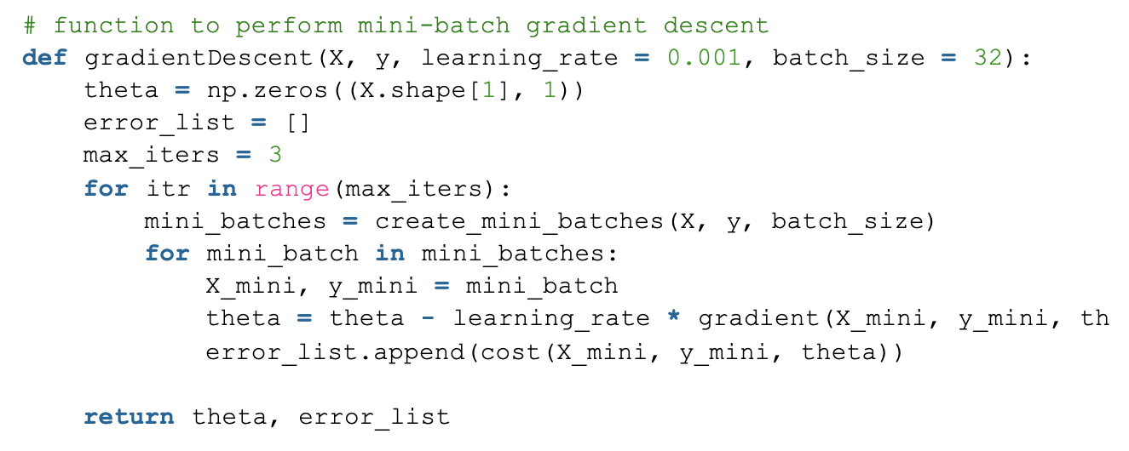
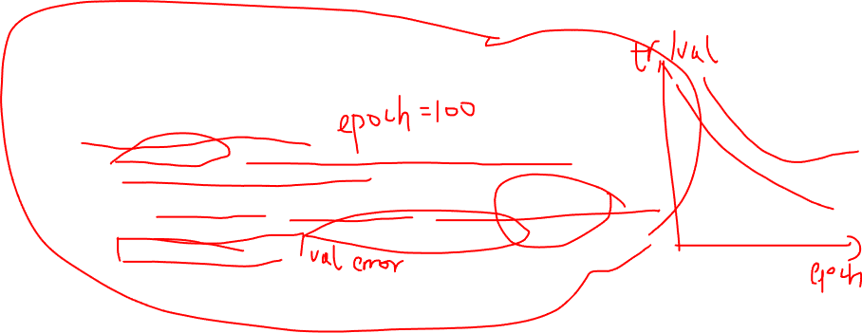
Linear Regression As an Example
Reference: https://www.geeksforgeeks.org/ml-mini-batch-gradient-descent-with-python/

Slide 13
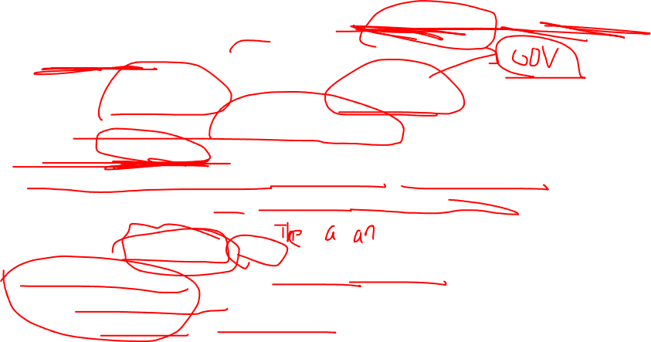
Dealing with Text Piplines – Tokenization & Cleaning, Use NLTK
Limit the vocabulary, throw out OOV vocabs
convert all letters to lower/upper case
removing numbers
Removing punctuation, white space, hyperlinks
stop words such as a, about, above, down, doing and the list goes on
Throw out infrequent/freq words.
Word Stemming(remove prefix/suffix)
Word Lemmatization(tried to convert the words back to its base form, e.g: past tense to present tense)

Slide 14
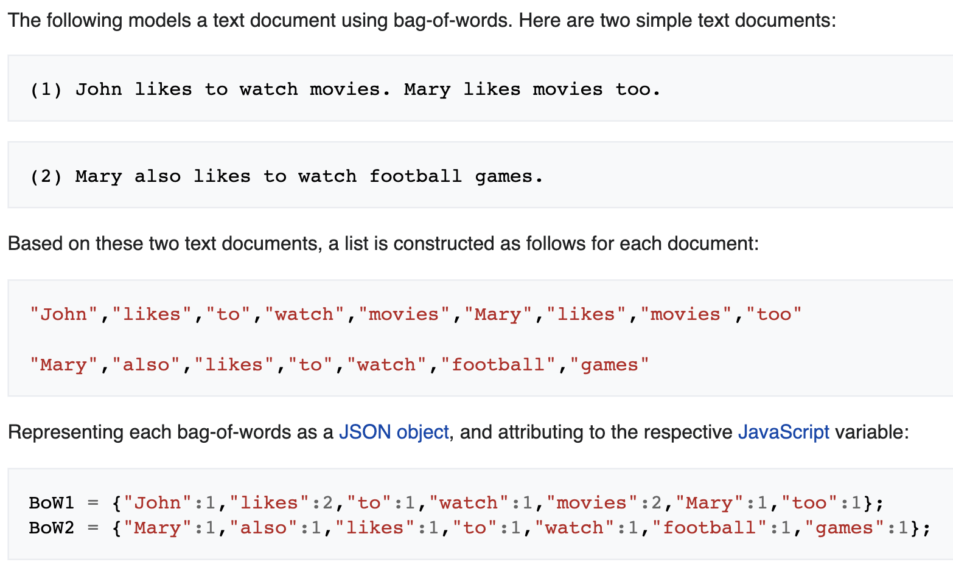

Dealing with Text Piplines – Text features
Bag of Words: (frequency of) occurrence of each word is used as a feature

Slide 15
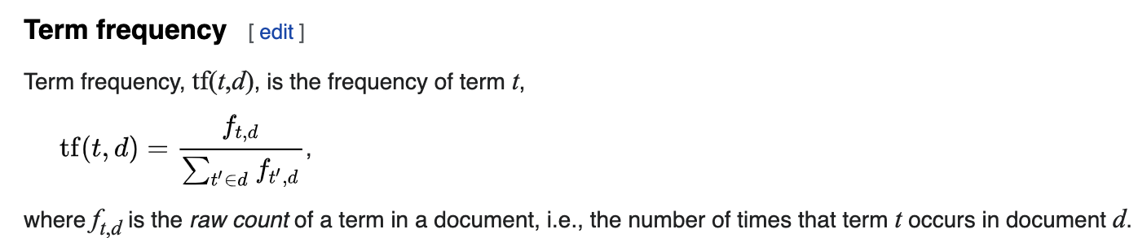
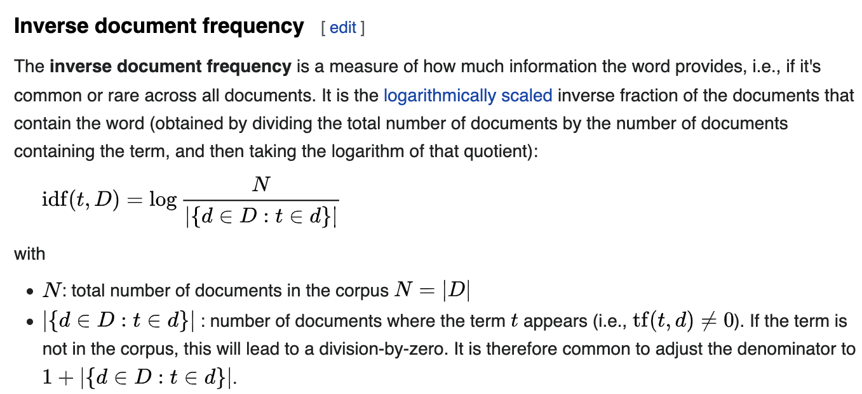
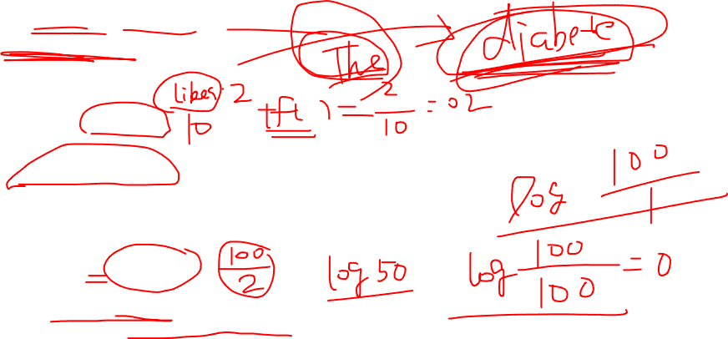
Dealing with Text Piplines – Text features
TF-IDF( term frequency–inverse document frequency):
TF-IDF = TF(t, D) x IDF(t, D)

Slide 16
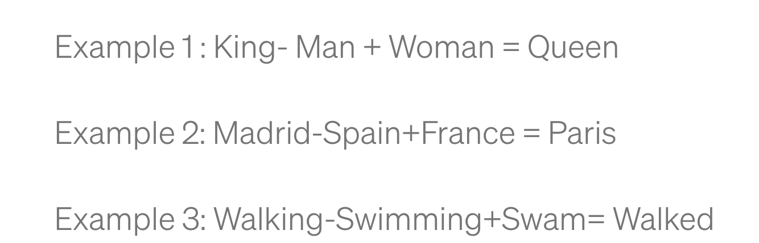
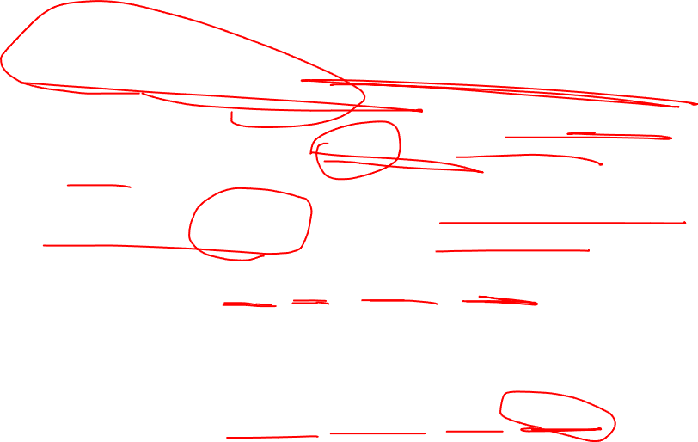
Word Embeddings(Algorithm Details ignored)
Word embedding is trying to convert a word to a vectorized format and this vector represents the position of this word in a higher dimensional space.
For words that have similar meaning, the cosine distance of those two word vectors will be shorter and they will be closer to each other.

Slide 17
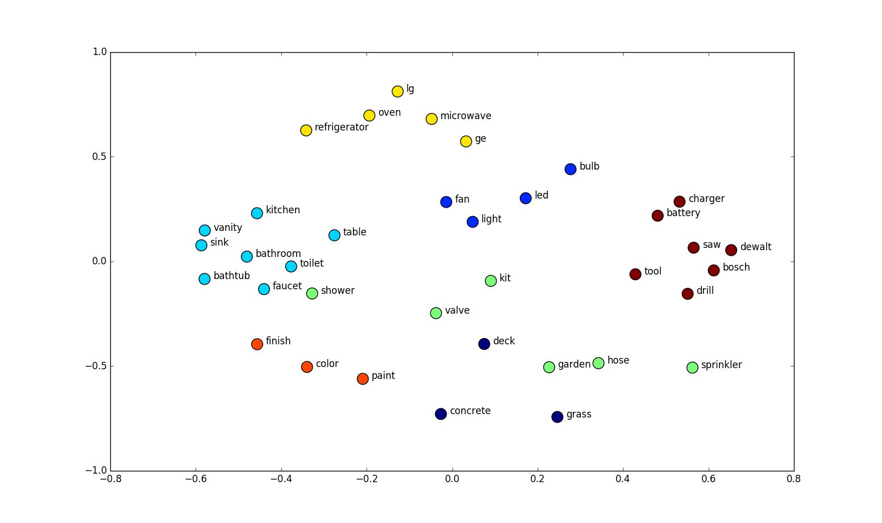

Word Embeddings(Algorithm Details ignored)

Slide 18
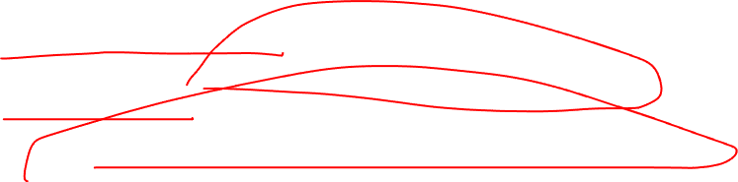
Common Used Word Embeddings(pretrained on different text corpus)
GloVe: Global Vectors for Word Representation(https://nlp.stanford.edu/projects/glove/)
Word2Vec: Efficient Estimation of Word Representations in Vector Space (https://wikipedia2vec.github.io/wikipedia2vec/pretrained/)

